Slide 1
LECTURE -6 (b)
Hypothesis Testing
Course Instructor
Engr. Naina Said

Slide 2
Hypothesis Testing for Single Mean
CSE-422: Data Analytics

Slide 3
Hypothesis Test for mean when Sigma is Known
CSE-422: Data Analytics
When we know about the population variance, we can use the z-statistics for testing our hypothesis.
After performing z statistics, we will get a numerical value.
Based on this value, we will decide whether to accept the null hypothesis or fail to accept. Reject the null hypothesis or fail to reject!
So we need to define a critical value which will act as a threshold for the test
value!.
Critical value is calculated based on alpha.

Slide 4
Finding the Z value for α
CSE-422: Data Analytics
For a left tailed test, use the z value that corresponds to the area equivalent to α
in the z-table (negative z).
For a right tailed test, use the z value that corresponds to the area equivalent to
1- α
For a two tailed test, use the z value that corresponds to α/2 for the left value. This will be a negative value. For the right value, use the z value that corresponds to 1- α/2. It will be positive.

Slide 5
Steps to Perform Hypothesis Testing
CSE-422: Data Analytics
State the null hypothesis and alternative hypothesis
Find the critical value.
Calculate test value.
Make the decision.
Summarize the results.

Slide 6
Example 1- LEFT Tailed Test
CSE-422: Data Analytics
It has been reported that the average credit card debt for college seniors is $3262. The student senate at a large university feels that their seniors have a debt much less than this, so it conducts a study of 50 randomly selected seniors and finds that the average debt is $2995, and the population standard deviation is $1100. Can we support the student senate’s claim using the data collected at α = 0.05?

Slide 7
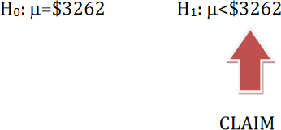
STEP 1- State the Null and Alternative hypothesis
CSE-422: Data Analytics

Slide 8
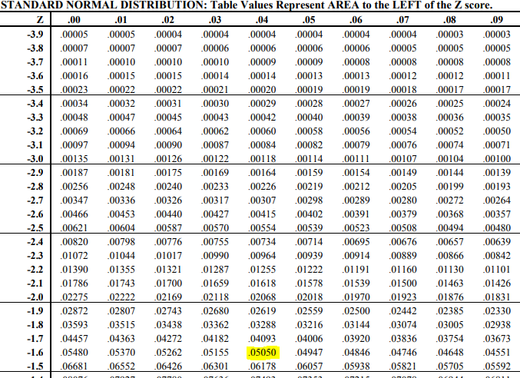
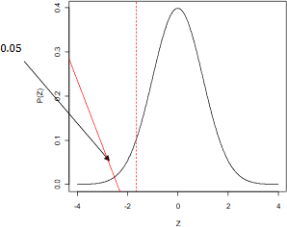
STEP 2- Find Critical Value
CSE-422: Data Analytics
This is a left tailed test, so use the z value that corresponds to the area equivalent to α in the z-table
CV = -1.64

Slide 9
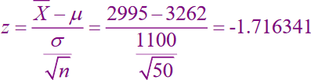
STEP 3- Calculate the Test Value
CSE-422: Data Analytics

Slide 10
Step 4- Make the Decision
CSE-422: Data Analytics
Since this is a left-tailed test, our rejection region consists of values of Z that are smaller than our critical value of Z = -1.64.
Since our test value (-1.716341) is less than our critical value (-1.64), reject the
null hypothesis.

Slide 11
Step 5- Summarize the Results
CSE-422: Data Analytics
We have evidence to support the student senate claim that the university’s seniors have credit card debt that is less than the reported average debt.
This is based on a Type I error rate of 0.05. This means we falsely make the
above claim 5% of the time.

Slide 12
Example 2- Two Tailed Problem
CSE-422: Data Analytics
The medical Rehabilitation Education Foundation reports that the average cost of rehabilitation for stroke victims is $24,672. To see if the average cost of rehab is different at a particular hospital, a researcher selects a random sample of 35 stroke victims at the hospital and finds the average cost of their rehab is $25,250. The standard deviation of the population is $3251. At α = 0.01, can it be concluded that the average cost of stroke rehabilitation at a particular hospital is different from
$24,672?

Slide 13

Hypothesis Test when Sigma is Unknown
CSE-422: Data Analytics
In reality, we hardly ever know the value of sigma.
The only difference between sigma known and sigma unknown case is
Use the sample standard deviation as a estimate of sigma.
Use T-Statistics instead of Z-Statistics.

Slide 14
Example 1
CSE-422: Data Analytics
We wish to check whether normal body temperature of human beings is less than
98.6 degrees. In a random sample of n=18 individuals, the sample mean was found to be 98.217 and the standard deviation was 0.684 . Does the data provide enough evidence to conclude that the normal body temperature of human beings is less than 98.6 degrees. Test at α = 0.05

Slide 15

STEP 1- State the Null and Alternative hypothesis
CSE-422: Data Analytics

Slide 16
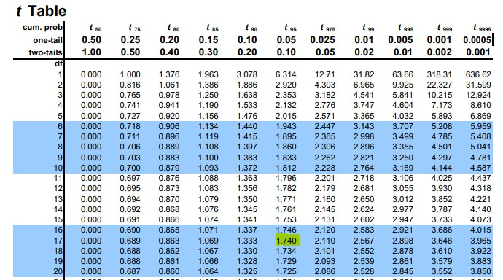
STEP 2- Find Critical Value
CSE-422: Data Analytics
Since n <30, we have to use t-statistics in this case. This is a left tailed test, so use the t value that corresponds to the area equivalent to α in the t-table with df=18-1
= 17 ( note the minus sign in CV)
T critical value = -1.740

Slide 17

STEP 3- Find Test Value
CSE-422: Data Analytics

Slide 18
Step 4- Make the Decision
CSE-422: Data Analytics
Our test value is smaller than the critical value of -1.74
Thus we reject the null hypothesis.

Slide 19
Step 5- Summarize the Results
CSE-422: Data Analytics
We have enough evidence to support the claim that the average body temperature of individuals is less than 98.6
This is based on a Type I error rate of 0.05. This means we falsely make the
above claim 5% of the time

Slide 20
Example 2
CSE-422: Data Analytics
A certain company would like to determine the amount of time employees waste at work each day. A random sample of 10 of its employees shows a mean time of
121.80 minutes wasted per day with a standard deviation of 9.45 minutes per day. Does the data provide evidence that the mean amount of time wasted by employees each day is more than 120 minutes? Test at α=.05.

Slide 21
Example 3
CSE-422: Data Analytics
Among 157 African-American men ,the mean systolic blood pressure was 146 mm Hg with a standard deviation of 27. We wish to know if on the basis of these data, we may conclude that the mean systolic blood pressure for a population of African- American is greater than 140. Use α=0.01.
(Sigma is unknown here, but notice the sample size)

Slide 22
Acknowledgment
CSE-422: Data Analytics
The content presented in these slides is inspired by miscellaneous resources
available online and offline.

